Slide 1
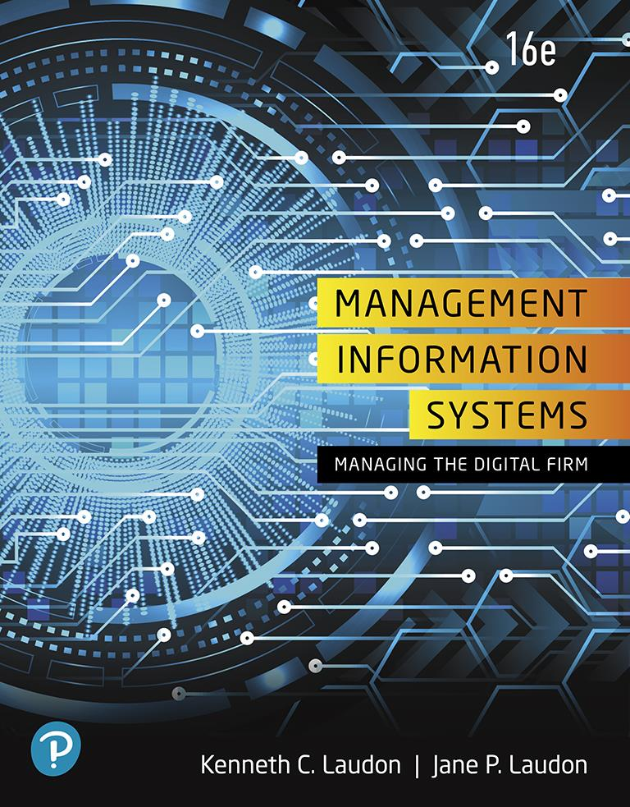
Management Information Systems: Managing the Digital Firm
Sixteenth Edition
Chapter 2
Global E-Business and Collaboration
Copyright © 2020, 2018, 2016 Pearson Education, Inc. All Rights Reserved
Notes:
If this PowerPoint presentation contains mathematical equations, you may need to check that your computer has the following installed:
1) MathType Plugin
2) Math Player (free versions available)
3) NVDA Reader (free versions available)

Slide 2
Learning Objectives
2.1 What are business processes? How are they related to information systems?
2.2 How do systems serve the different management groups in a business, and how do systems that link the enterprise improve organizational performance?
2.3 Why are systems for collaboration and social business so important, and what technologies do they use?
2.4 What is the role of the information systems function in a business?
2.5 How will MIS help my career?
Notes:
This chapter is designed to provide students a quick overview of the kinds of systems found in a typical corporation. Some of the concepts were introduced in Chapter 1. You could ask students to recall and describe the different levels of management in a business, intranets, and business processes using information from the previous chapter. Some are new—such as enterprise wide systems.

Slide 3
Video Cases
Case 1: Walmart’s Retail Link Supply Chain
Case 2: Cemex: Becoming a Social Business
Instructional Video: U S Foodservice Grows Market with Oracle C R M on Demand

Slide 4
Enterprise Social Networking Helps Sanofi Pasteur Innovate and Improve Quality (1 of 2)
Problem
Hierarchical top-down processes
Large geographically dispersed workforce
Lack of collaboration and idea sharing
Solutions
Develop knowledge sharing strategy and goals
Redesign knowledge and collaboration processes
Change organizational culture
Implement Microsoft Yammer collaboration software

Slide 5
Enterprise Social Networking Helps Sanofi Pasteur Innovate and Improve Quality (2 of 2)
Use of new technology to engage employees and enabled knowledge gathering and sharing
Demonstrates how outdated processes can affect knowledge sharing and innovation
Illustrates why organizations rely on information systems to improve performance and remain competitive

Slide 6
Business Processes (1 of 2)
Business processes
Flows of material, information, knowledge
Logically related set of tasks that define how specific business tasks are performed
May be tied to functional area or be cross-functional
Businesses: Can be seen as collection of business processes
Business processes may be assets or liabilities
Notes:
Business processes are at the heart of every business. Ask students if they can give any examples of business processes that they come in contact with everyday. This could include anything from ordering a hamburger at McDonalds, to applying for a driver's license at the DMV. Emphasize that studying a firm's business processes is an excellent way to learn a great deal about how that business actually works. How could a business process be a liability? Think of some dysfunctional business processes or ask the students to come up with some really poor business process.

Slide 7
Business Processes (2 of 2)
Examples of functional business processes
Manufacturing and production
Assembling the product
Sales and marketing
Identifying customers
Finance and accounting
Creating financial statements
Human resources
Hiring employees
Notes:
Other examples include checking the product for quality (manufacturing and production), selling the product (sales and marketing), paying creditors (finance and accounting), and evaluating job performance (human resources). You could ask students to contribute other examples of business processes and describe which of the four types they are.

Slide 8
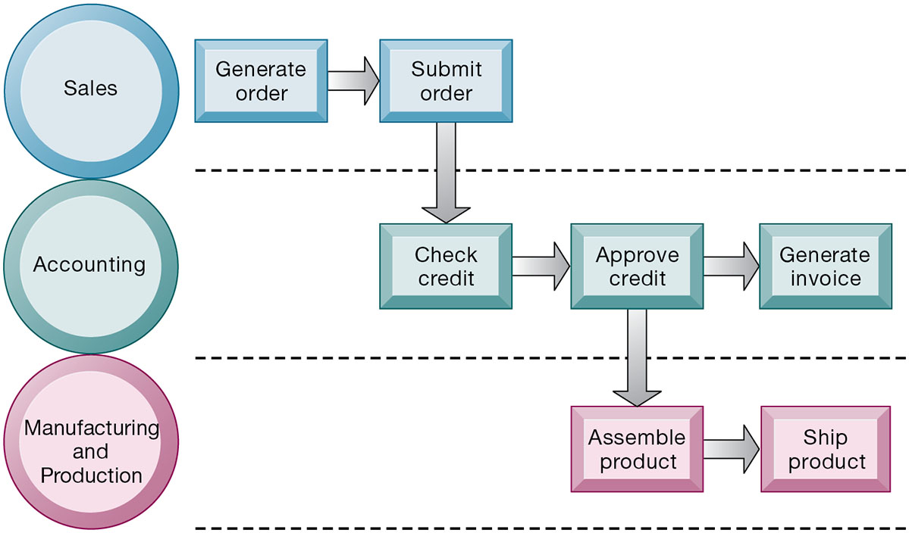
Figure 2.1 The Order Fulfillment Process
Notes:
Figure 2.1, Page 43.
Fulfilling a customer order involves a complex set of steps that requires the close coordination of the sales, accounting, and manufacturing functions.
Emphasize that each rectangle represents one part of the larger business process of order fulfillment. Notice that this business process spans several different functional areas of the business from sales (orders), to accounting, to manufacturing. Important business processes typically span several different functional areas or divisions in a business.
Full description: A diagram depicts the steps on three different levels that are involved in an order fulfillment process. The first level is labeled, Sales, and the following items are listed. Generate order, Submit order. The next level is labeled, Accounting, and the following items are listed. Check credit, Approve credit, Generate invoice. From the, Approve credit, step of, Accounting, the process also proceeds to the Manufacturing and Production level, under which the following items are listed. Assemble product, Ship product.

Slide 9
How Information Technology Improves Business Processes
Increasing efficiency of existing processes
Automating steps that were manual
Enabling entirely new processes
Changing flow of information
Replacing sequential steps with parallel steps
Eliminating delays in decision making
Supporting new business models
Notes:
Examples of entirely new business processes made possible by information technology are downloading a song from iTunes or buying a book or e-book from Amazon. You might also mention the Amazon book reader Kindle which is continuously connected to the Internet and allows customers to download books and pay for them using Amazon’s one-click purchase method. Ask students if they can name any other business processes that have been transformed in the last year years.

Slide 10
Systems for Different Management Groups (1 of 2)
Transaction processing systems
Serve operational managers and staff
Perform and record daily routine transactions necessary to conduct business
Examples: sales order entry, payroll, shipping
Allow managers to monitor status of operations and relations with external environment
Serve predefined, structured goals and decision making
Notes:
The purpose of these systems is to answer routine questions about the flow of transactions through the organization. These systems are a necessity for any business.

Slide 11
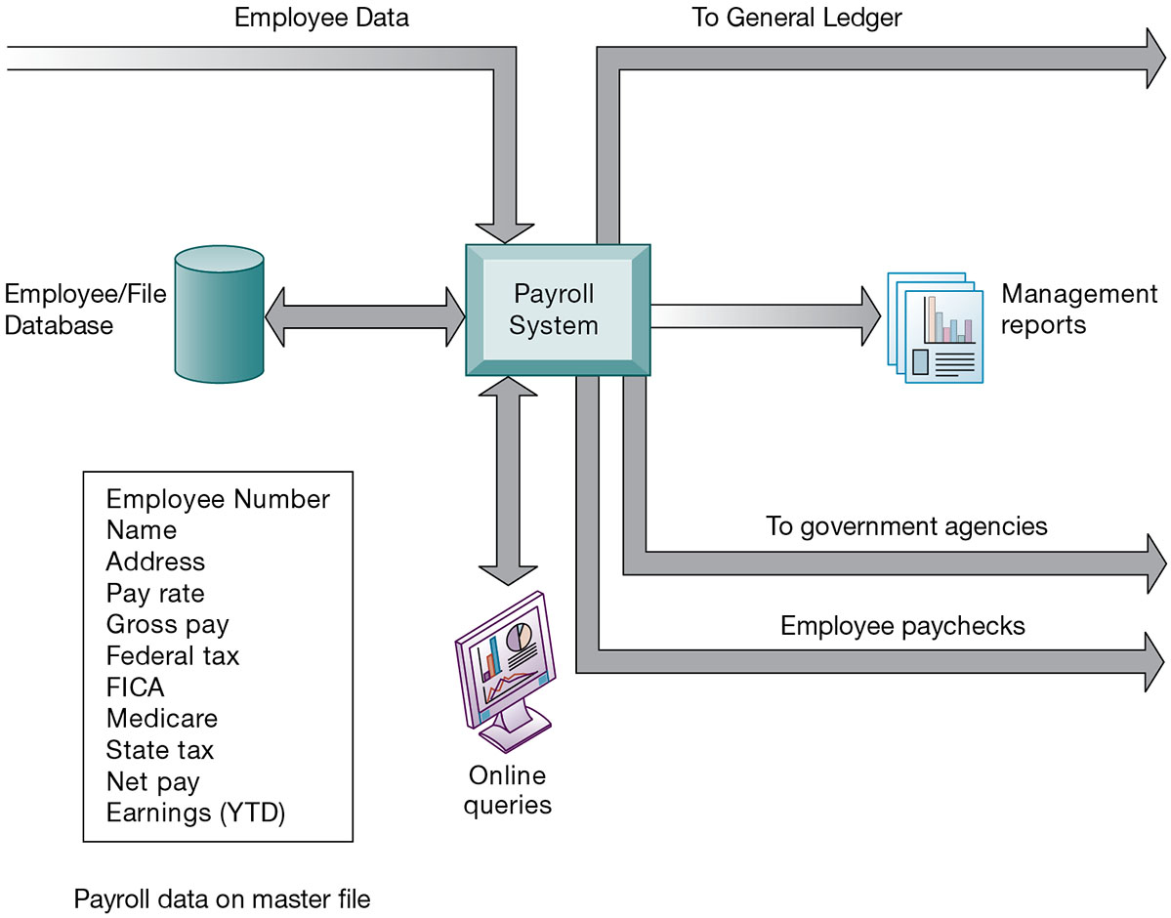
Figure 2.2 A Payroll T P S
Notes:
Figure 2.2, Page 47.
A TPS for payroll processing captures employee payment transaction data (such as a time card). System outputs include online and hard-copy reports for management and employee paychecks.
Note that the outputs of the payroll system are useful not only within the company to managers, but also to regulatory agencies and other entities relying on the accuracy of the reported data.
Full description: A diagram depicts the inputs and outputs of a transaction processing system for payroll. At the center is the Payroll System. A main input to this system is employee data. The payroll system receives input from the employee file database as well as provides updates to this database. The system also has a reciprocal relationship with users and online queries. Payroll data in a master file, or database, would include, for example, the following items. Employee Number. Name. Address. Pay rate. Gross pay. Federal tax. F I C A. Medicare. State tax. Net pay. Earnings, Y T D. Data from the payroll system would then create output in the following various forms. To General Ledger. Management reports. To government agencies. Employee paychecks.

Slide 12
Systems for Different Management Groups (2 of 2)
Systems for business intelligence
Data and software tools for organizing and analyzing data
Used to help managers and users make improved decisions
Management information systems
Decision support systems
Executive support systems
Notes:
This slide emphasizes the relationship between the class of software called “business intelligence” and the decision support systems used by middle and senior management, DSS and ESS. Business intelligence is a type of software used in analyzing data.

Slide 13
Management Information Systems
Serve middle management
Provide reports on firm’s current performance, based on data from T P S
Provide answers to routine questions with predefined procedure for answering them
Typically have little analytic capability
Notes:
Emphasize to students that management information systems is a specific category of information systems for middle management. It has the same name, but a very different meaning from the term introduced in Chapter 1 (the study of information systems in business and management). In other words, the study of management information systems involves looking at all the systems used in business. An MIS system is a specific type of an IS. It’s easy to get the two confused.

Slide 14
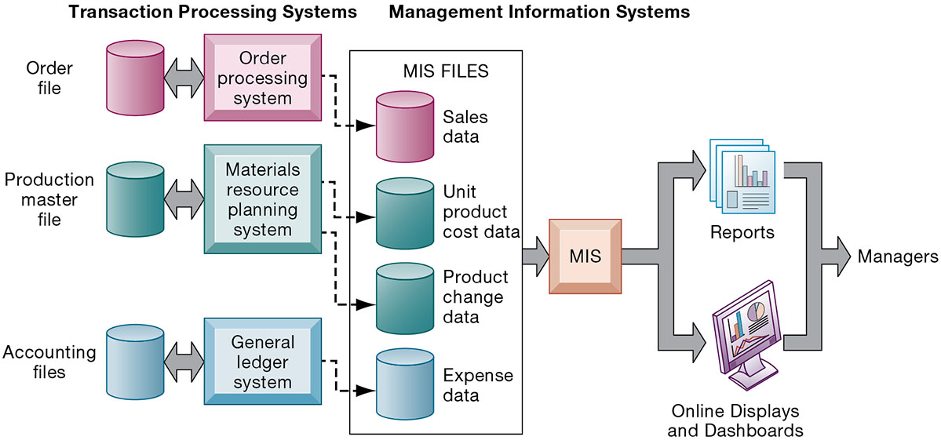
Figure 2.3 How Management Information Systems Obtain Their Data from the Organization’s T P S
Notes:
Figure 2.3, Page 48.
In the system illustrated by this diagram, three TPS supply summarized transaction data to the MIS reporting system at the end of the time period. Managers gain access to the organizational data through the MIS, which provides them with the appropriate reports.
Emphasize the relationship between TPS and MIS here. MIS receive data from an organization’s TPS systems and create outputs that management can use to make strategic decisions.
Full description: A Diagram depicts the data outputs from an organization’s transaction processing system. On the left side of the diagram are the transaction processing systems, labeled as follows. Order processing system, which receives and transmits data to order files. Materials resource planning system, which receives and transmits data to production master file. General ledger system, which receives and transmits data to accounting files. On the right side of the diagram are the management information systems, listed as follows. Sales data are received from the order processing system. Unit product cost data and product change data are received from the materials resource planning system. Expense data are received from the general ledger system. These outputs of the M I S systems form the reports, often in the form of online displays and dashboards, to managers.

Slide 15
Figure 2.4 Sample M I S Report
Consolidated Consumer Products Corporation Sales by Product and Sales Region: 2019
Product Code | Product Description | Sales Region | Actual Sales | Planned | Actual Versus Planned
4469 | Carpet Cleaner | Northeast South Midwest West | 4,066,700 3,778,112 4,867,001 4,003,440 | 4,800,000 3,750,000 4,600,000 4,400,000 | 0.85 1.01 1.06 0.91
Blank | Total | Blank | 16,715,253 | 17,550,000 | 0.95
5674 | Room Freshener | Northeast South Midwest West | 3,676,700 5,608,112 4,711,001 4,563,440 | 3,900,000 4,700,000 4,200,000 4,900,000 | 0.94 1.19 1.12 0.93
Blank | Total | Blank | 18,559,253 | 17,700,000 | 1.05
Notes:
Figure 2.4, Page 48.
This report, showing summarized annual sales data, was produced by the MIS in Figure 2.3.
This graphic represents the “reports” portion of the Figure 2-3. Emphasize this to students, perhaps referencing that slide again to drive home that point. Students may not understand the decimals in the “ACTUAL versus PLANNED” category, where anything above 1.00 represents more sales than planned and anything less represents a disappointing result of fewer sales than planned.

Slide 16
Decision Support Systems
Serve middle management
Support nonroutine decision making
Example: What is the impact on production schedule if December sales doubled?
May use external information as well T P S / M I S data
Model driven D S S
Voyage-estimating systems
Data driven D S S
Intrawest’s marketing analysis systems
Notes:
You could ask whether or not students understand what is meant by nonroutine decision making, as opposed to routine decision making, and why DSS are specifically designed to assist managers in making that type of decision. Ask students for examples of nonroutine decisions they make or have made in the past as managers or employees.

Slide 17
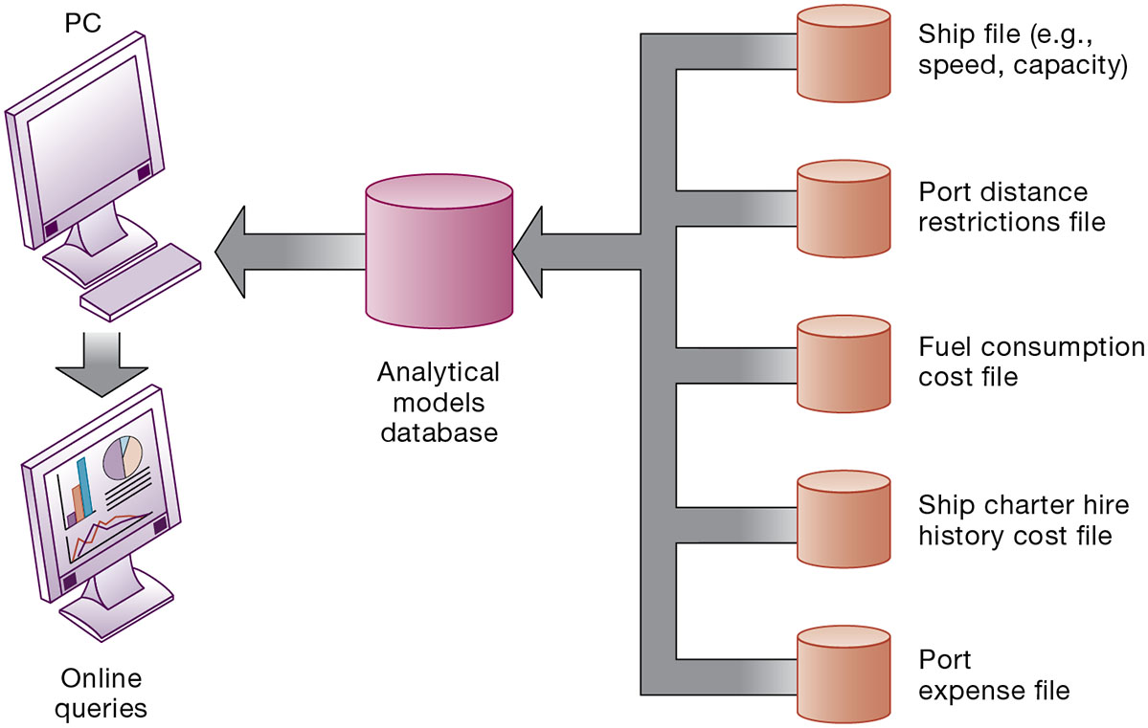
Figure 2.5 Voyage-Estimating Decision-Support System
Notes:
Figure 2.5, Page 50.
This DSS operates on a powerful PC. It is used daily by managers who must develop bids on shipping contracts.
DSS can rely on either analytical models or large databases to provide valuable information. You could ask which of these two types the above figure best resembles (analytical models). You could also ask them what types of decisions does this system help its users make? Examples include what vessels to send to particular destinations to maximize profit, the optimal loading pattern for cargo, and the optimal rate at which vessels should travel to maximize efficiency while still meeting their schedules, and so forth.
Full description: In the diagram, the inputs to the analytical models database are as follows. Ship file, such as speed or capacity. Port distance restrictions file. Fuel consumption cost file. Ship charter hire history cost file. Port expense file. This database is available via P C's and allows for entry of or obtaining information.

Slide 18
Executive Support Systems
Support senior management
Address nonroutine decisions
Requiring judgment, evaluation, and insight
Incorporate data about external events (e.g., new tax laws or competitors) as well as summarized information from internal M I S and D S S
Example: Digital dashboard with real-time view of firm’s financial performance
Notes:
Emphasize the connection between ESS, MIS, and DSS. ESS rely on accurate inputs from a firm’s MIS and DSS to provide useful information to executives. These systems should not exist in isolation from one another. If they are isolated from one another, it is a kind of organizational dysfunction, probably inherited from the past. Note that the digital dashboard is a common feature of modern-day ESS. Emphasize that a critical feature of ESS is ease of use and simplicity of display. Executives using an ESS want quick access to the most critical data affecting their firm.

Slide 19
Interactive Session: Management : Data Changes How N F L Teams Play the Game and How Fans See It
Class discussion
What kinds of systems are illustrated in this case study? Where do they obtain their data? What do they do with the data? Describe some of the inputs and outputs of these systems.
What business functions do these systems support? Explain your answer.
How do the data about teams and players captured by the N F L help N F L football teams and the N F L itself make better decisions? Give examples of two decisions that were improved by the systems described in this case.
How did using data help the N F L and its teams improve the way they run their business?
Notes:
If all teams have access to the NFL Player Tracking System will the system give a competitive advantage to individual teams? Teams may differ in their ability to use the system effectively, their analytic capabilities may differ. So the competitive advantage would go to those teams with a management capability and culture suitable to the new technology. The point here is that management and organizational changes are required to make effective use of the technology.

Slide 20
Enterprise Applications
Systems for linking the enterprise
Span functional areas
Execute business processes across the firm
Include all levels of management
Four major applications
Enterprise systems
Supply chain management systems
Customer relationship management systems
Knowledge management systems
Notes:
Enterprise applications are used to manage the information used in the systems discussed previously. In other words, enterprise applications are used to ensure that TPS, MIS, DSS, and ESS work together smoothly.

Slide 21
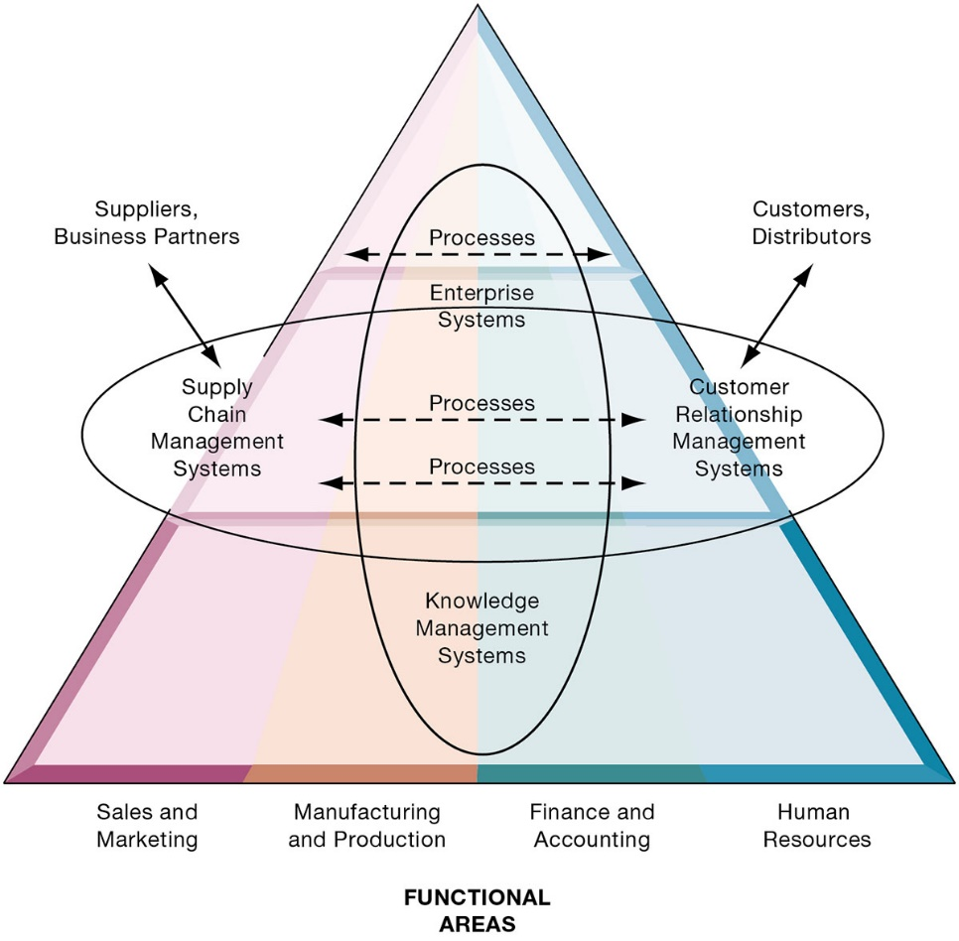
Figure 2.6 Enterprise Application Architecture
Notes:
Figure 2.6, Page 53.
Enterprise applications automate processes that span multiple business functions and organizational levels and may extend outside the organization.
The purpose of this graphic is simply to illustrate that enterprise systems are very large and diverse databases that pull information from many parts of the firm and enable processes across the firm at different organizational levels, as well as with suppliers and customers.
The triangle represents the organization, with different colors for the four main business functions. The ovals show that an enterprise application architecture incorporates systems used in sales and marketing, enabling these to communicate with each other and externally, with suppliers and customers. It also incorporates information supplied by knowledge management systems, manufacturing and finance systems, and other enterprise systems. The purpose of incorporating data and information from all of these sources is to enable and automate cross-functional business processes and supply accurate information to aid decision making.
Full description: In the diagram, a triangle representing enterprise applications is divided vertically into four functional areas, Labeled respectively as follows. Sales and marketing. Manufacturing and production. Finance and accounting. Human resources. A vertical oval encompasses most of the manufacturing and production and finance accounting areas contains the Knowledge Management Systems and the Enterprise Systems. A horizontal oval that overlaps the center of the vertical oval contains the central processes of all four functional areas. Within that oval are the Supply Chain Management Systems, which pertain to suppliers and business partners, and the Customer Relationship Management Systems, which pertain to customers and distributors.

Slide 22
Enterprise Systems
Also called enterprise resource planning (E R P) systems
Integrate data from key business processes into single system.
Speed communication of information throughout firm.
Enable greater flexibility in responding to customer requests, greater accuracy in order fulfillment.
Enable managers to assemble overall view of operations.
Notes:
This slide emphasizes the singularity of enterprise systems (one system) that integrates information flows from a variety of sources and serves a wide variety of groups and purposes in the firm. Remind students of the difference between enterprise applications and enterprise systems: Enterprise applications are any applications that span the enterprise, and types of enterprise applications include CRM, SCM, KMS, and enterprise systems. Enterprise systems refers to the larger database environment within which these applications reside and operate.
Note that enterprise systems are referred to in some first as enterprise resource planning systems (ERP).

Slide 23
Supply Chain Management (S C M) Systems
Manage relationships with suppliers, purchasing firms, distributors, and logistics companies.
Manage shared information about orders, production, inventory levels, and so on.
Goal is to move correct amount of product from source to point of consumption as quickly as possible and at lowest cost
Type of interorganizational system: Automating flow of information across organizational boundaries
Notes:
Emphasize that SCM systems are interorganizational systems, automating the flow of information across organizational boundaries. This distinction is important because SCM systems must be designed with the business processes of potential partners and suppliers in mind.

Slide 24
Customer Relationship Management (C R M) Systems
Help manage relationship with customers.
Coordinate business processes that deal with customers in sales, marketing, and customer service
Goals:
Optimize revenue
Improve customer satisfaction
Increase customer retention
Identify and retain most profitable customers
Increase sales
Notes:
CRM systems are extremely important for both marketing and customer service. You could ask students if they’ve ever filled out a survey for a company. Then connect that to information systems, perhaps explaining that the information they entered was provided as input to a CRM system for analysis.

Slide 25
Knowledge Management Systems (K M S)
Manage processes for capturing and applying knowledge and expertise
Collect relevant knowledge and make it available wherever needed in the enterprise to improve business processes and management decisions.
Link firm to external sources of knowledge
Notes:
The idea that business firms are repositories of knowledge may be new to many students. Ask students for examples of firm knowledge, for instance, the knowledge required to run a fast food restaurant, or the knowledge required to operate a website such as Amazon. Explain that knowledge management systems are useful for helping a firm's employees understand how to perform certain business processes or how to solve problems. What might the consequences be for a firm with poor knowledge management systems?

Slide 26
Intranets and Extranets
Technology platforms that increase integration and expedite the flow of information
Intranets:
Internal networks based on Internet standards
Often are private access area in company’s Web site
Extranets:
Company Web sites accessible only to authorized vendors and suppliers
Facilitate collaboration
Notes:
Enterprise applications are typically extremely expensive as well as difficult to implement. Ask students why this would be so:
Intranets and extranets use Internet technology to communicate internally to employees, allow employees to communicate with one another and share documents, and to help communication with vendors. They are essentially password protected websites. The simplest intranets and extranets may use static webpages to relay information, whereas more sophisticated versions may be database-driven and enable key business processes.
Ask students if they have used an intranet or extranet before and what services or information it provided. Does their school have an intranet/extranet? Generally universities have a website with different levels of access for the general public, registered students, faculty, and administrators. The public-facing part of the website can be thought of as the “extranet,” whereas the part of the website serving students and faculty can be thought of as the “intranet.” These terms (intranet and extranet) are fading from use, but students will occasionally find firms still using them.

Slide 27
E-Business, E-Commerce, and E-Government
E-business
Use of digital technology and Internet to drive major business processes
E-commerce
Subset of e-business
Buying and selling goods and services through Internet
E-government
Using Internet technology to deliver information and services to citizens, employees, and businesses
Notes:
The use of Internet technology has transformed and continues to transform businesses and business activity. This slide aims to distinguish different terminology used in the book.
E-business refers to the use of the Internet and networking to enable all parts of the business, whereas e-commerce refers to just that part of business that involves selling goods and services over the Internet.
Internet technology has also brought similar changes in the public sector—the use of Internet and networking technologies in government is referred to as e-government. Ask students what changes in businesses or government due to new Internet technologies they have noticed.

Slide 28
What is Collaboration?
Collaboration
Short lived or long term
Informal or formal (teams)
Growing importance of collaboration
Changing nature of work
Growth of professional work—“interaction jobs”
Changing organization of the firm
Changing scope of the firm
Emphasis on innovation
Changing culture of work
Notes:
A number of factors are leading to a growing emphasis on collaboration in the firm. Work is changing, requiring more cooperation and coordination. Professions play a larger role in firms than before, and this often requires more consultation among experts. Organizations are flatter, with many more decisions made far down in the hierarchy. Organizations are more far flung around the globe, in multiple locations. There’s an emphasis on finding and sharing ideas, which requires collaboration. Finally, what it means to be a “good” employee these days is in part an ability to work with others, and collaborate effectively. The culture of work has changed.

Slide 29
What is Social Business?
Social business
Use of social networking platforms (internal and external) to engage employees, customers, and suppliers
Aims to deepen interactions and expedite information sharing
“Conversations” to strengthen bonds with customers
Requires information transparency
Seen as way to drive operational efficiency, spur innovation, accelerate decision making
Notes:
Ask students how they use social sites such as Facebook, and if they have ever used these sites for business purposes. How about Twitter, Pinterest, or Tumblr?

Slide 30
Business Benefits of Collaboration and Teamwork
Investment in collaboration technology can return large rewards, especially in sales and marketing, research and development
Productivity: Sharing knowledge and resolving problems
Quality: Faster resolution of quality issues
Innovation: More ideas for products and services
Customer service: Complaints handled more rapidly
Financial performance: Generated by improvements in factors above
Notes:
Research regarding the business benefits of collaboration is anecdotal; however, business and academic communities generally regard collaboration as an essential driving factor in business success: Firms that collaborate more make more money.
Ask students to give examples of how collaboration can improve productivity, product quality, and customer service. Has anyone had a fruitful collaborative experience in which an aspect of a company they worked at or an organization they were in?

Slide 31
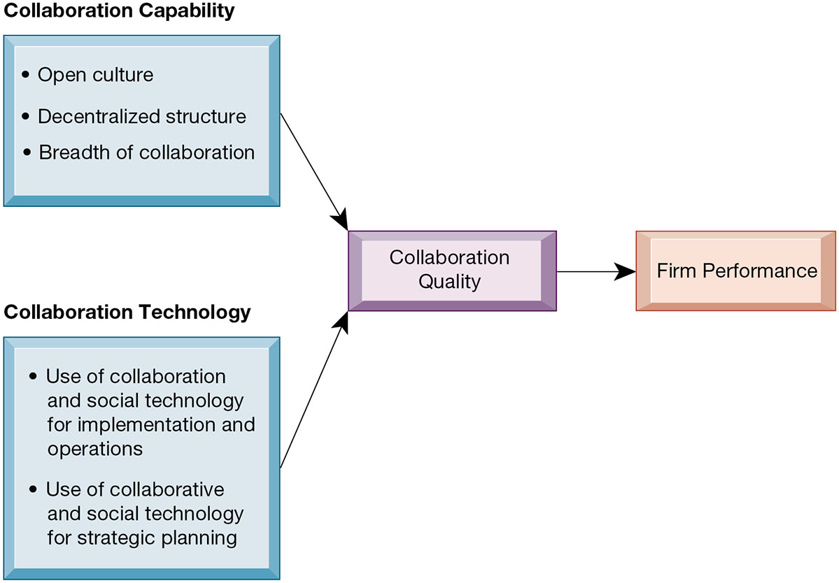
Figure 2.7 Requirements for Collaboration
Notes:
Figure 2.7, Page 59.
Successful collaboration requires an appropriate organizational structure and culture along with appropriate collaboration technology.
This slide graphically describes how collaboration is believed to impact business performance. Two primary ingredients are needed: collaboration capability (including how much collaboration is possible) and collaboration technology or means. The quality of these two factors directly affects firm performance—the higher quality of collaboration means better firm performance. Ask students how collaboration can be high or low quality? An example of low-quality collaboration could be a team put together to solve a business problem but is unable to effectively work together because of internal politics. Do students have any experience with poor collaboration?
Full description: A diagram indicates that firm performance is dependent on collaboration quality. Collaboration quality is dependent on both capability and technology. Collaboration capability consists of the following criteria. Open culture. Decentralized structure. Breadth of collaboration. Collaboration technology consists of the following criteria. Use of collaboration and social technology for implementation and operations. Use of collaborative and social technology for strategic planning.

Slide 32
Building a Collaborative Culture and Business Processes
“Command and control” organizations
No value placed on teamwork or lower-level participation in decisions
Collaborative business culture
Senior managers rely on teams of employees
Policies, products, designs, processes, and systems rely on teams
The managers purpose is to build teams
Notes:
Collaboration is not something that spontaneously arises—it must be enabled and nurtured. Collaborative culture is an essential factor—simply having collaborative technology will not result in collaboration if it isn’t seen as part of the business and rewarded. Have any students worked at “command and control” organizations? If so, were they able to see aspects of the business that could be improved but were unable to make contributions because of the firm's culture? Are there any businesses or business functions that benefit by less collaboration? Are there any disadvantages to collaboration?

Slide 33
Tools and Technologies for Collaboration and Social Business
E-mail and instant messaging (I M)
Wikis
Virtual worlds
Collaboration and social business platforms
Virtual meeting systems (telepresence)
Cloud collaboration services (Google Drive, Google Docs, etc.)
Microsoft SharePoint and I B M Notes
Enterprise social networking tools
Notes:
The text goes into more depth on each of these tools. Give an example for each type of tool. Business uses of social networking and collaboration include Facebook accounts for businesses; using wikis as extended, more complete FAQs; and virtual worlds to conduct online meetings for employees around the world. Distinguish these individual tools from Internet-based collaboration environments, which are suites of collected collaboration tools, enabling communication and data-sharing between tools. How many of your students used Google Docs?
Nearly all the features you see on Facebook are re-created in enterprise social networking software. Facebook does not have team workspaces, Google+ makes it easier to set these up as communities.

Slide 34
Interactive Session: Technology: Videoconferencing: Something for Everyone
Class discussion
Compare the capabilities of Cisco’s IX5000 telepresence and the Logitech SmartDock systems. How do they promote collaboration and innovation?
Why would a company like Produban want to invest in a high-end telepresence system such as Cisco’s IX5000? How is videoconferencing technology and telepresence related to Produban’s business model and business strategy?
Why would King County, Washington want to implement the Logitech SmartDock system? What business benefits did it obtain from using this technology?

Slide 35
Checklist for Managers: Evaluating and Selecting Collaboration and Social Software Tools
Time/space matrix
Six steps in evaluating software tools
Identify your firm’s collaboration challenges
Identify what kinds of solutions are available
Analyze available products’ cost and benefits
Evaluate security risks
Consult users for implementation and training issues
Evaluate product vendors
Notes:
When evaluating collaboration tools for your businesses, the first step is to identify the kind of problem you have. The key problems are time and location. Generally, no one has enough time and often key people are not in the right place. Some teams may need to work together in real-time, whereas others may simply need shared documentation. In analyzing collaboration tools by the space/time dimensions you can determine what types of tools will solve your problem. The six steps in evaluating software are applicable not only for collaboration tools but any software solution for your company. First determine the challenge or problem, look for solutions for this particular problem, and so forth.

Slide 36
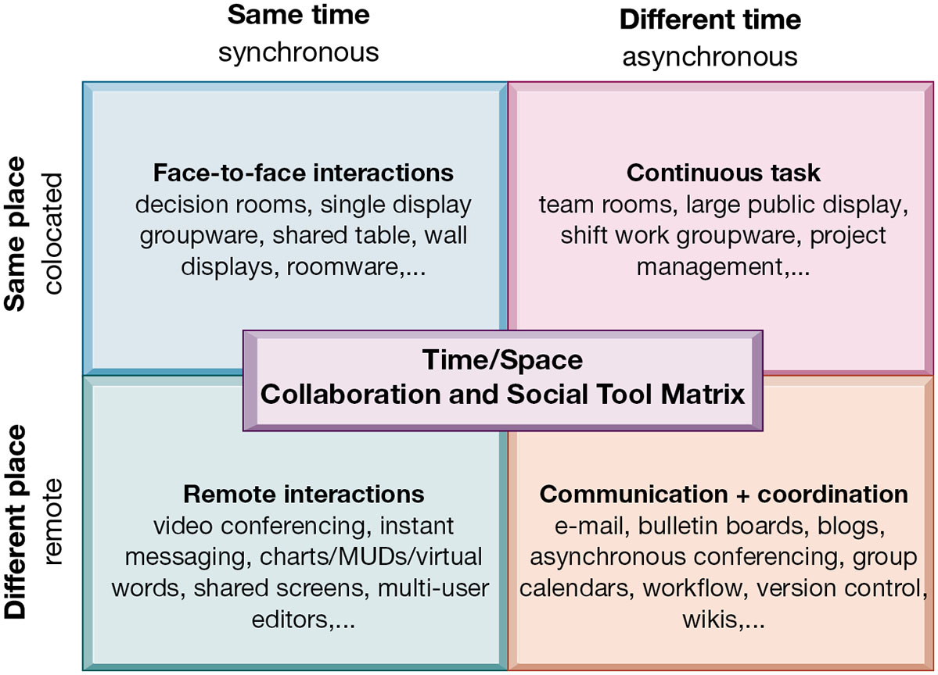
Figure 2.8 The Time/Space Collaboration and Social Tool Matrix
Notes:
Figure 2.8, Page 65.
Collaboration and social technologies can be classified in terms of whether they support interactions at the same or different time or place and whether these interactions are remote or colocated.
You can use this matrix to identify solutions to the time/location issues that face a firm, and to choose specific collaboration technologies.
Full description: A diagram depicts a matrix of the time/place relationship of collaboration and social technologies. The matrix contains four areas indicating time and place aspects of collaboration. At the Upper left in the matrix are the labels, Same time, synchronous, Same place, collocated, and, Face to face interactions, decision rooms, single display groupware, shared table, wall displays, roomware, etcetera. At the Lower left in the matrix are the labels, Same time, synchronous, Different place, remote, and, Remote interactions, video conferencing, instant messaging, charts, M U D's, virtual words, shared screens, multi user editors, etcetera. At the Upper right in the matrix are the labels, Different time, asynchronous, Same place, collocated, and, Continuous task, team rooms, large public display, shift work groupware, project management, etcetera. At the Lower right in the matrix are the labels, Different time, asynchronous, Different place, remote, and, Communication plus coordination, e mail, bulletin boards, blogs, asynchronous conferencing, group calendars, workflow, version control, etcetera.

Slide 37
The Information Systems Department
Often headed by chief information officer (C I O)
Other senior positions include chief security officer (C S O), chief knowledge officer (C K O), chief privacy officer (C P O), chief data officer (C D O)
Programmers
Systems analysts
Information systems managers
End users
Notes:
Defined simply, the information systems department of a firm is responsible for coordinating all of the systems previously mentioned in this chapter. How the department is organized depends on the nature and size of the business. Small companies may not have a formal department, whereas large companies may have several departments for different business functions, or they have an IT Department in each corporate division. Ask students what types of information systems departments they have had experience with.
As the development of business information systems matures, end users have been increasingly recognized as pivotal to developing a successful system.

Slide 38
Organizing the Information Systems Function
I T governance
Strategies and policies for using I T in the organization
Decision rights
Accountability
Organization of information systems function
Centralized, decentralized, and so on
Notes:
The information systems department has also been recognized as a powerful resource for developing new products, services, and efficiencies. As such, IT governance is a central business concern—being able to use IT efficiently and effectively has become more and more essential to a business’s success.

Slide 39
How Will MIS Help My Career?
The Company: Comprehensive Supplemental Insurance USA
Position: Sales support specialist
Job Requirements
Interview Questions
Author Tips

Slide 40

Copyright
This work is protected by United States copyright laws and is provided solely for the use of instructors in teaching their courses and assessing student learning. Dissemination or sale of any part of this work (including on the World Wide Web) will destroy the integrity of the work and is not permitted. The work and materials from it should never be made available to students except by instructors using the accompanying text in their classes. All recipients of this work are expected to abide by these restrictions and to honor the intended pedagogical purposes and the needs of other instructors who rely on these materials.

